Slide 1
Smart HR
23CCE286 Database Management System
Lithigesh P G – [CB.EN.U4CCE23025]
Sriharish V J – [CB.EN.U4CCE23051]
Sanjay V J – [CB.EN.U4CCE23053]

Slide 2
Table of contents
01
02
03
Motivation
Objectives
Methodology
04
05
06
07
Schema Diagram
ER Diagram
User Interface
Flowchart
Outcomes

Slide 3
MOTIVATION
Inefficiencies in Traditional HR – Manual processes in HR management lead to errors, delays, and inefficiencies.
Need for Automation – Automating tasks like payroll, employee records, and onboarding improves accuracy and saves time.
Enhancing Employee Experience – A centralized system simplifies access to records, benefits, and performance tracking.
Compliance & Legal Adherence – Ensuring organizations follow labor laws and internal policies efficiently.
Data-Driven Decision Making – HR analytics help organizations track employee performance, training needs, and retention strategies.
Scalability for Future Growth – A digital HR system can easily adapt as the company expands, reducing administrative burden.

Slide 4
OBJECTIVES
Centralized Employee Management – To create a unified system for storing and managing all employee-related data, including personal details, job history, and payroll records.
Automation of HR Processes – To automate key HR functions such as onboarding, payroll processing, and leave management, reducing manual effort and increasing efficiency.
Improved Workforce Coordination – To enhance coordination between HR departments and employees by providing a structured and transparent flow of information.
Enhanced Data Security – To ensure the confidentiality and protection of sensitive employee data, complying with organizational policies and legal regulations.
Scalable and Efficient System – To develop a scalable HR solution that can adapt to the organization's growth and integrate seamlessly with other business tools.
Optimized Employee Lifecycle Management – To effectively manage the entire employee lifecycle, from recruitment to exit, ensuring a smooth and well-documented transition process.

Slide 5
METHODOLOGY
Requirement Analysis – Identifies key entities like Employees, Payroll, Leave Requests, and Performance Management, focusing on admin-level access with future expansion plans.
Database Design – Uses MySQL with an ER diagram, normalization, primary/foreign keys, and constraints to ensure data integrity.
System Architecture – Follows a three-tier model: Frontend (HTML, CSS, JS, EJS), Backend (Node.js), and Database (MySQL).
Implementation – Develops UI with EJS, integrates Node.js for authentication and business logic, and ensures efficient CRUD operations in MySQL.
.
Testing & Validation – Includes Unit, Integration, UAT, and Security Testing for reliability, performance, and secure access.
Deployment & Maintenance – Hosted on Vercel/Render with modular scalability, regular updates, and future AI-based enhancements.

Slide 6
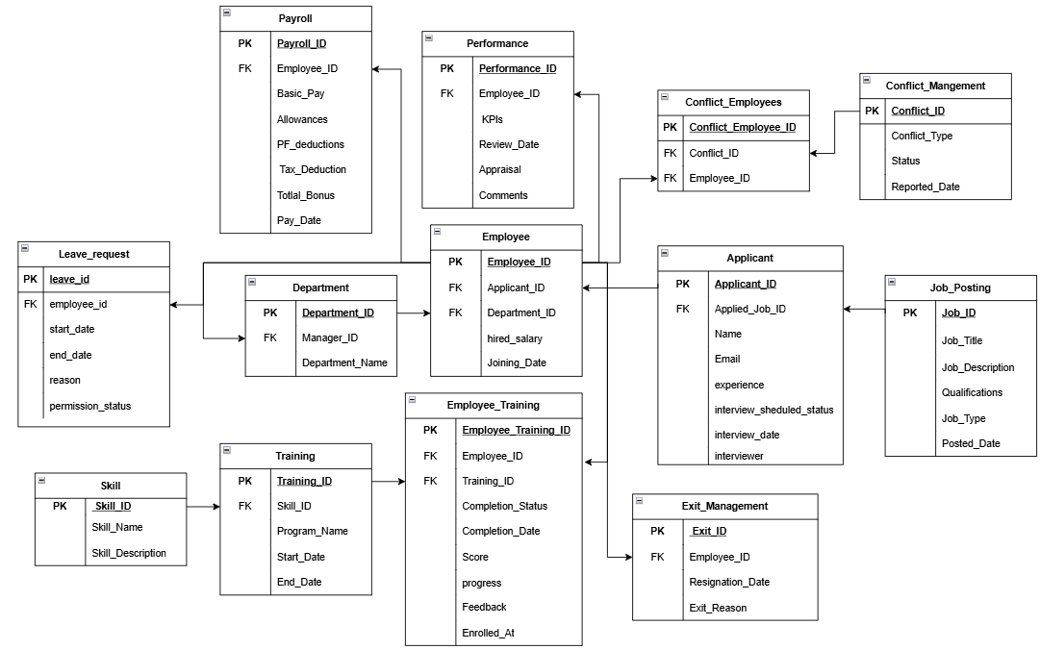
SCHEMA DIAGRAM

Slide 7
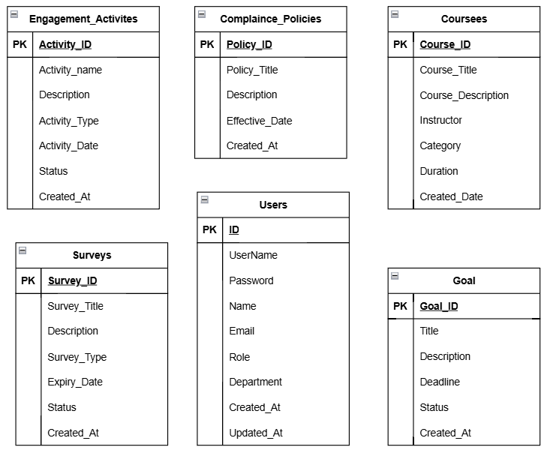
SCHEMA DIAGRAM

Slide 8
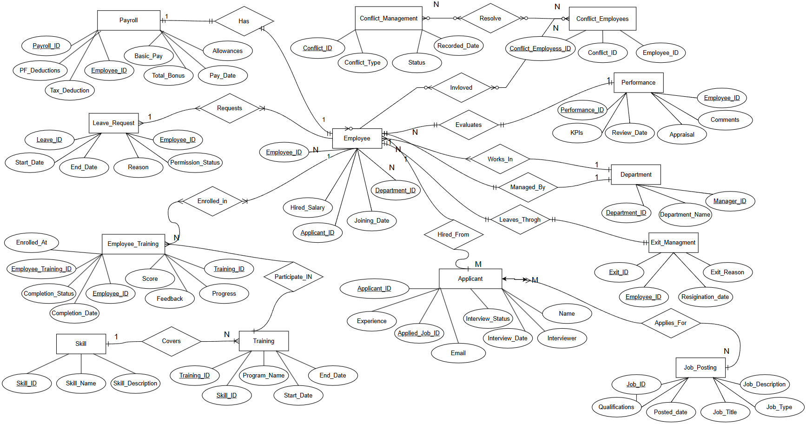
ER DIAGRAM

Slide 9
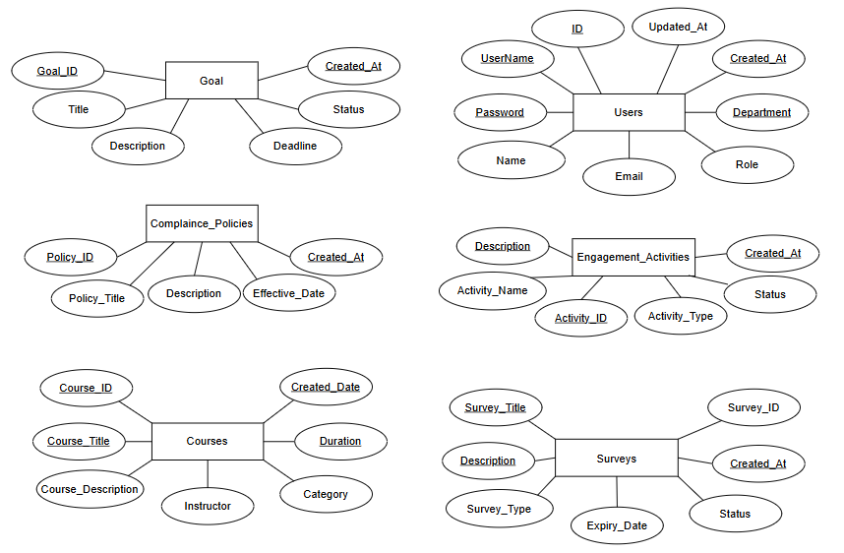
ER DIAGRAM

Slide 10
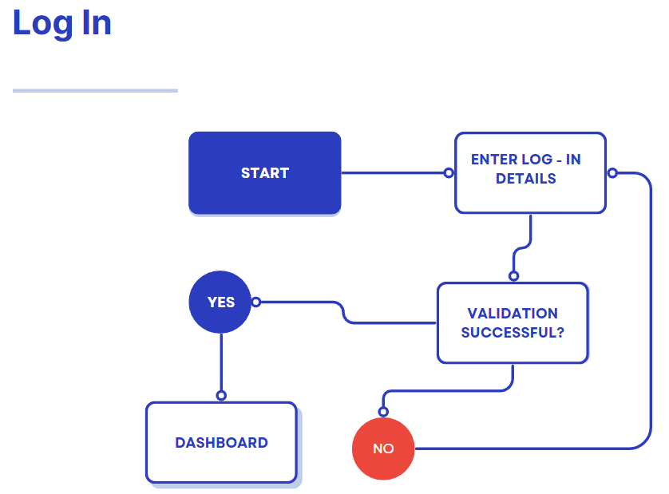
UI Flowchart
Log - In

Slide 11
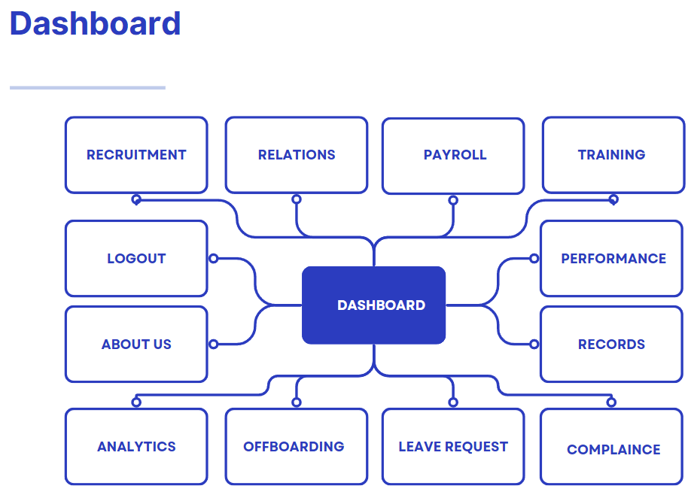
UI Flowchart
Dashboard

Slide 12
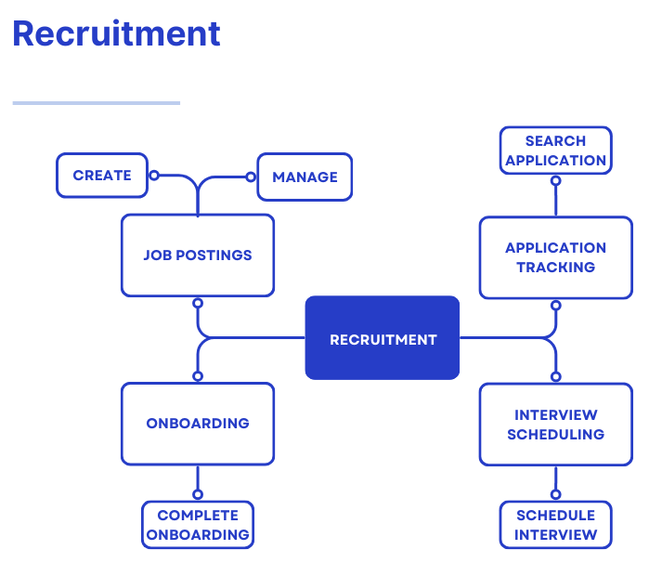
UI Flowchart
Recruitment

Slide 13
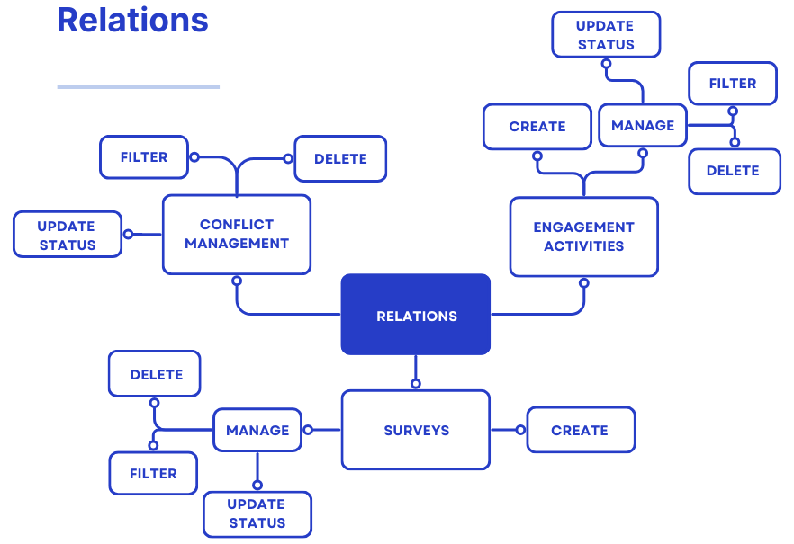
UI Flowchart
Relations

Slide 14
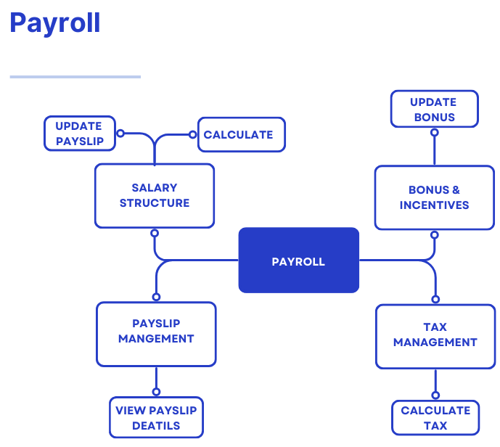
UI Flowchart
Payroll

Slide 15
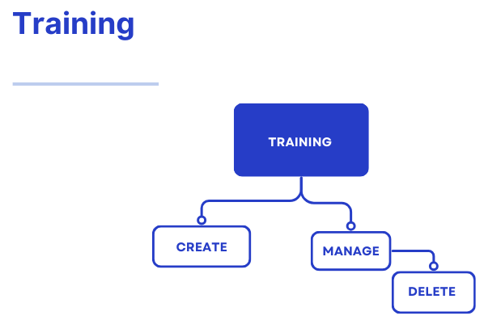
UI Flowchart
Training

Slide 16
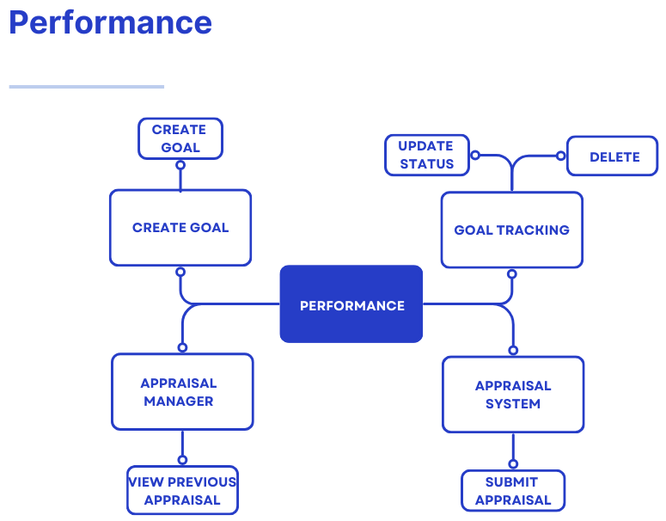
UI Flowchart
Performance

Slide 17
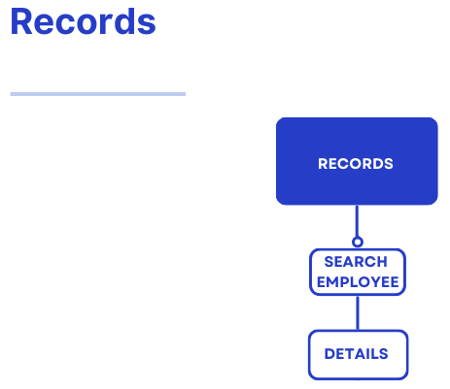
UI Flowchart
Records

Slide 18
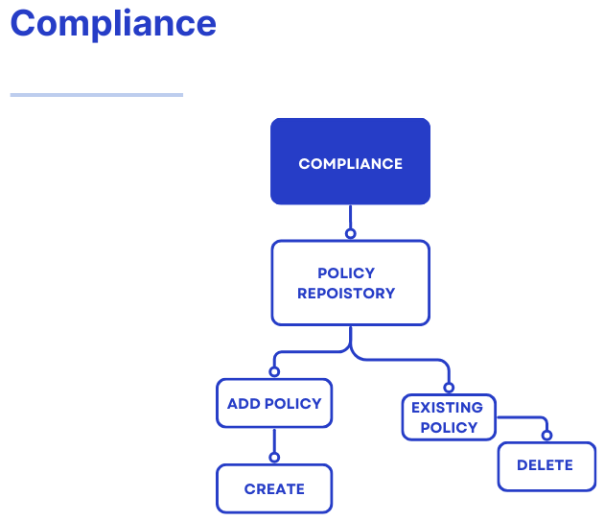
UI Flowchart
Compliance

Slide 19
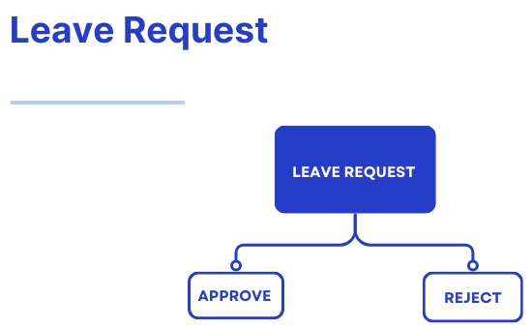
UI Flowchart
Leave Request

Slide 20
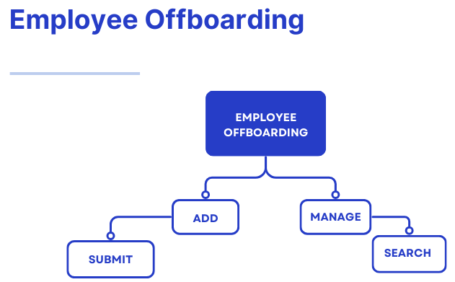
UI Flowchart
Offboarding

Slide 21
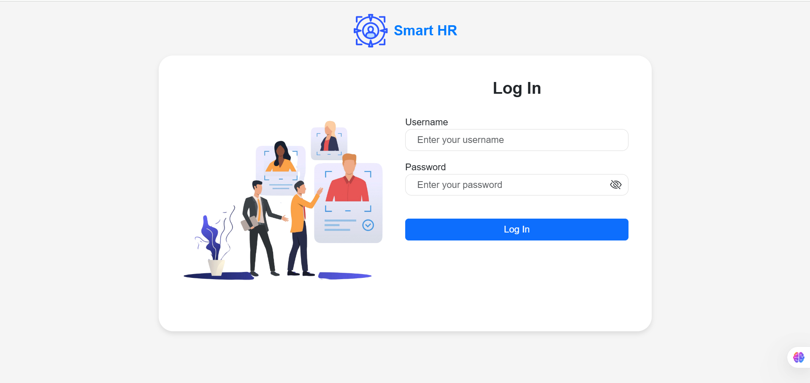
Outcomes
Log – In Page

Slide 22
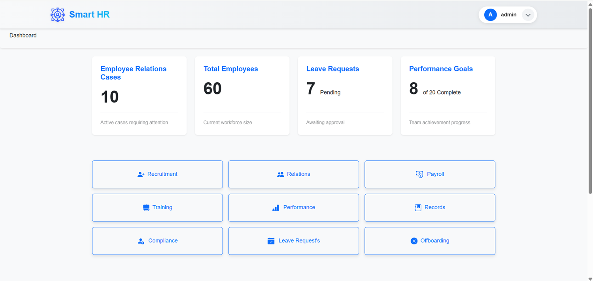
Outcomes
Dashboard Page

Slide 23
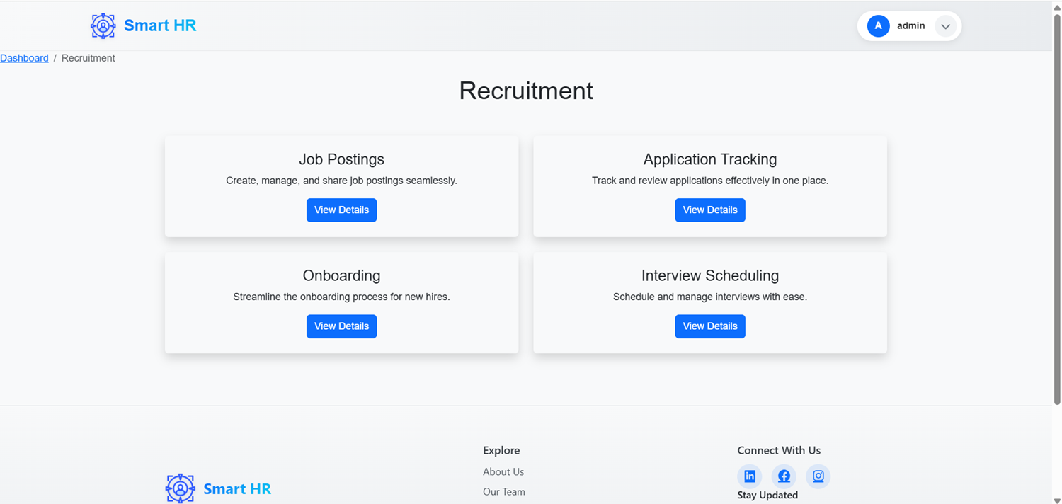
Outcomes
Recruitment Page

Slide 24
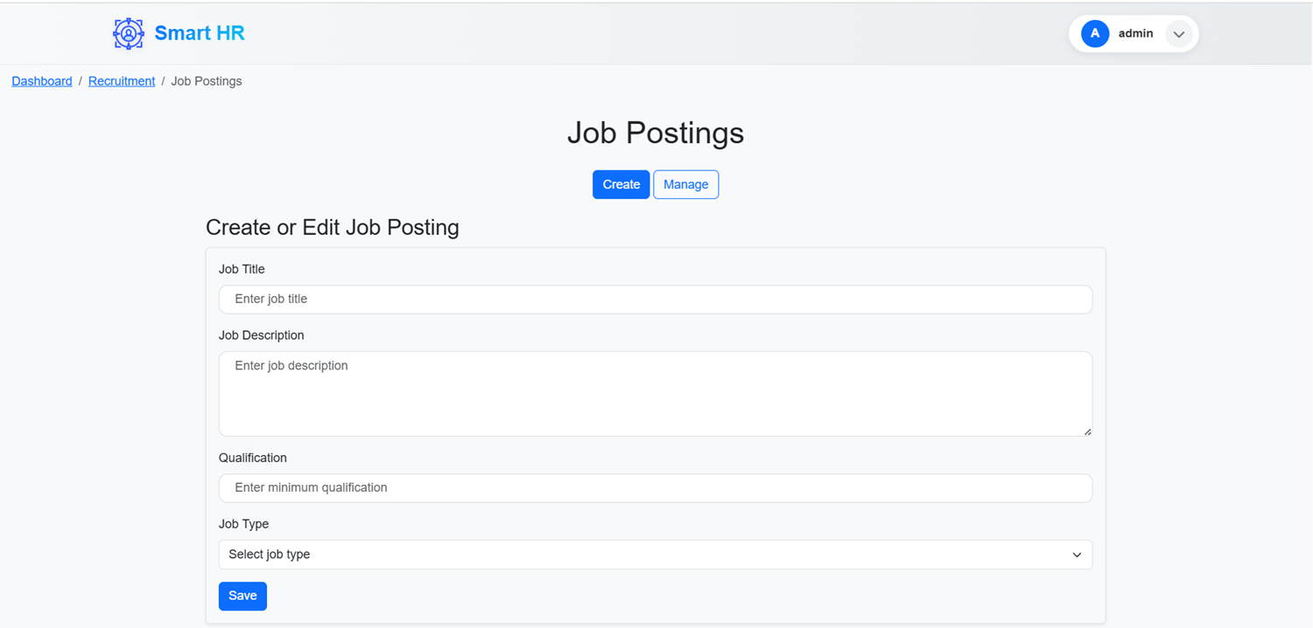
Outcomes
Job Postings Page (Create Section)

Slide 25
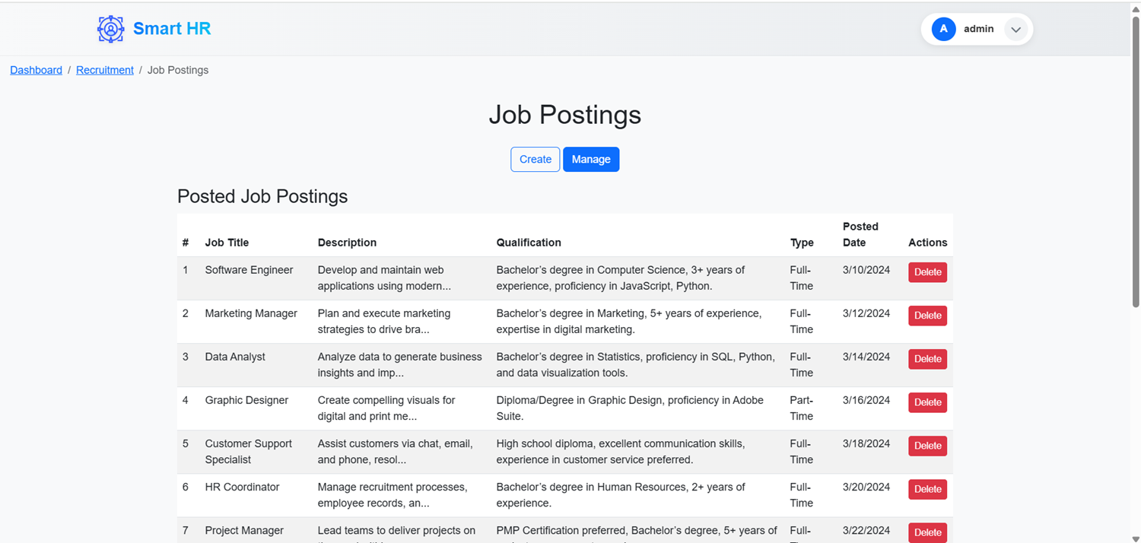
Outcomes
Job Postings Page (Manage Section)

Slide 26
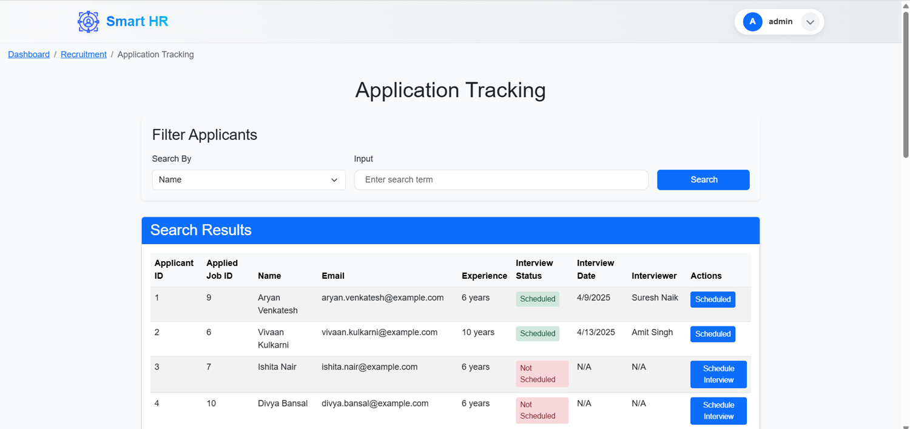
Outcomes
Application Tracking Page

Slide 27
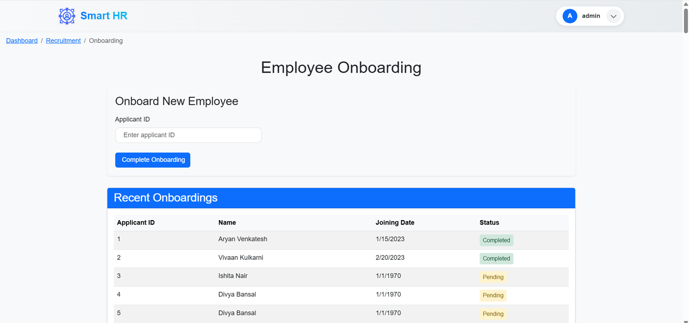
Outcomes
Onboarding Page

Slide 28
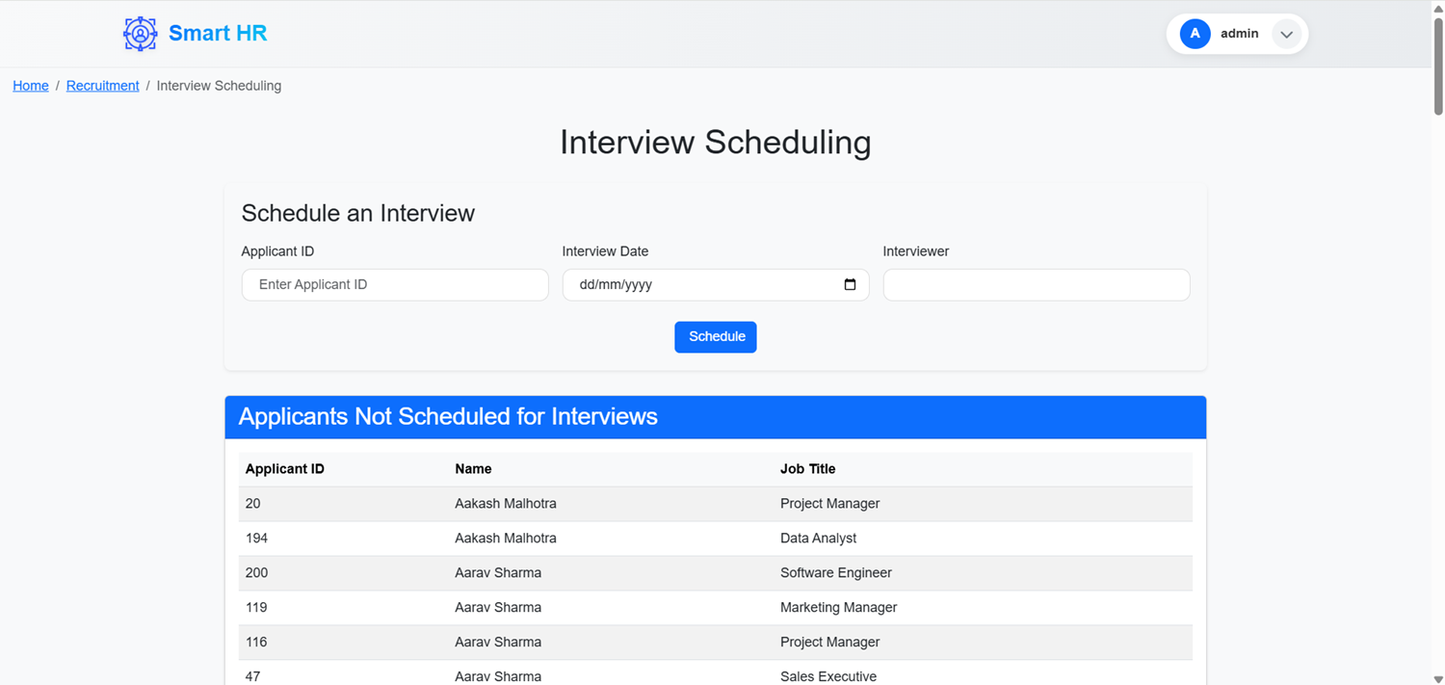
Outcomes
Interview Scheduling Page

Slide 29
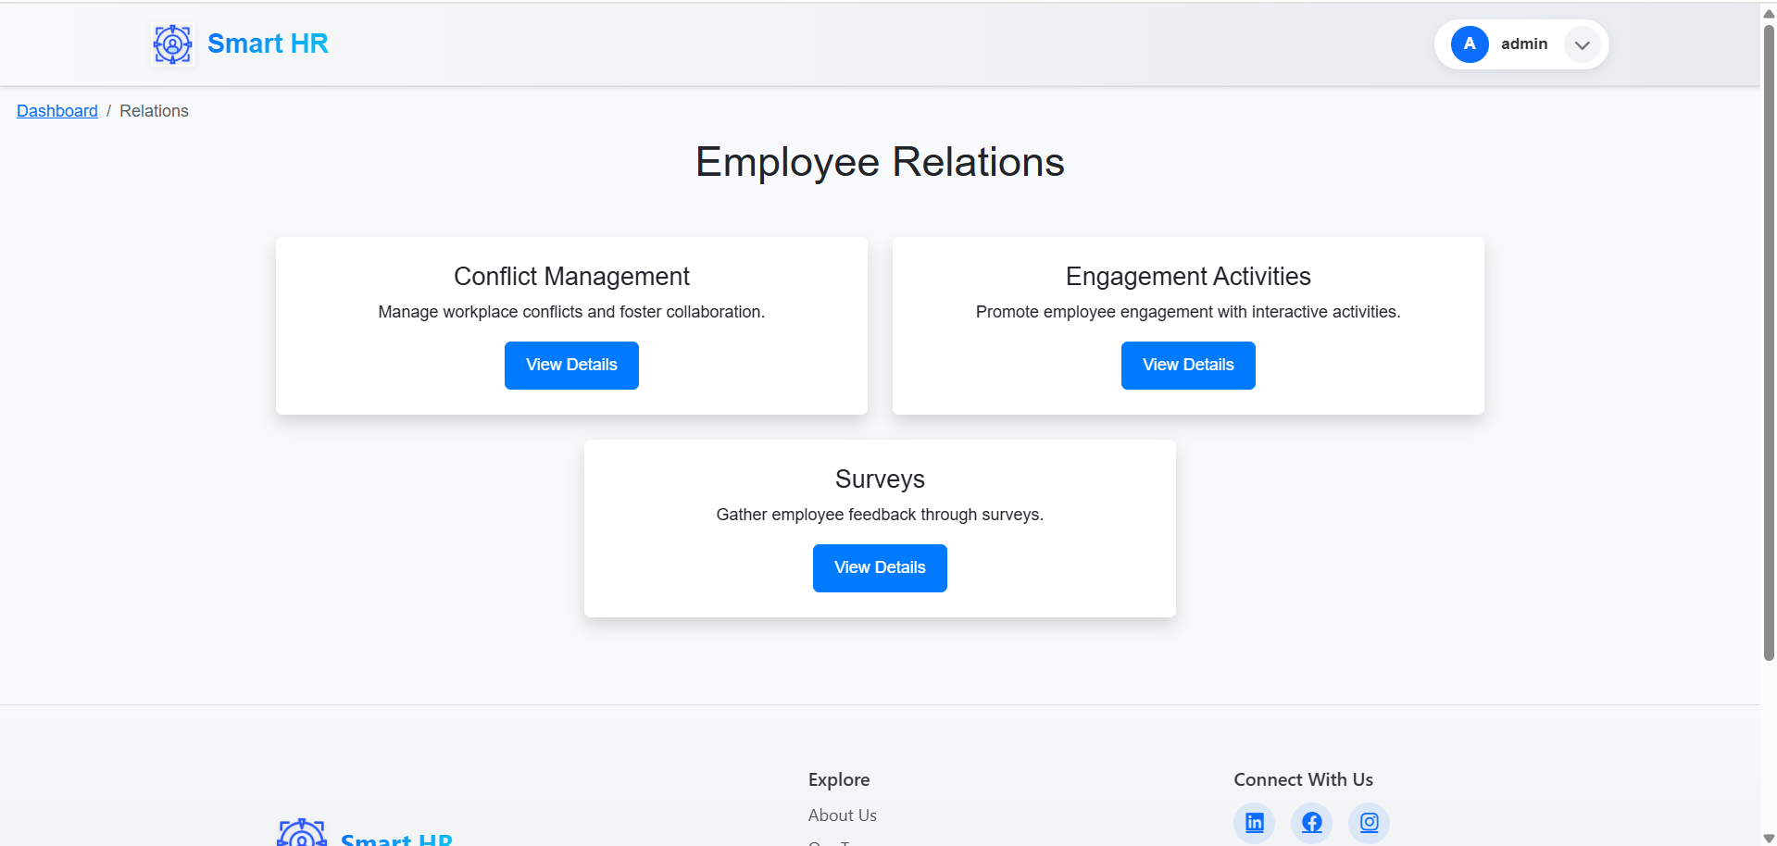
Outcomes
Relations Page

Slide 30
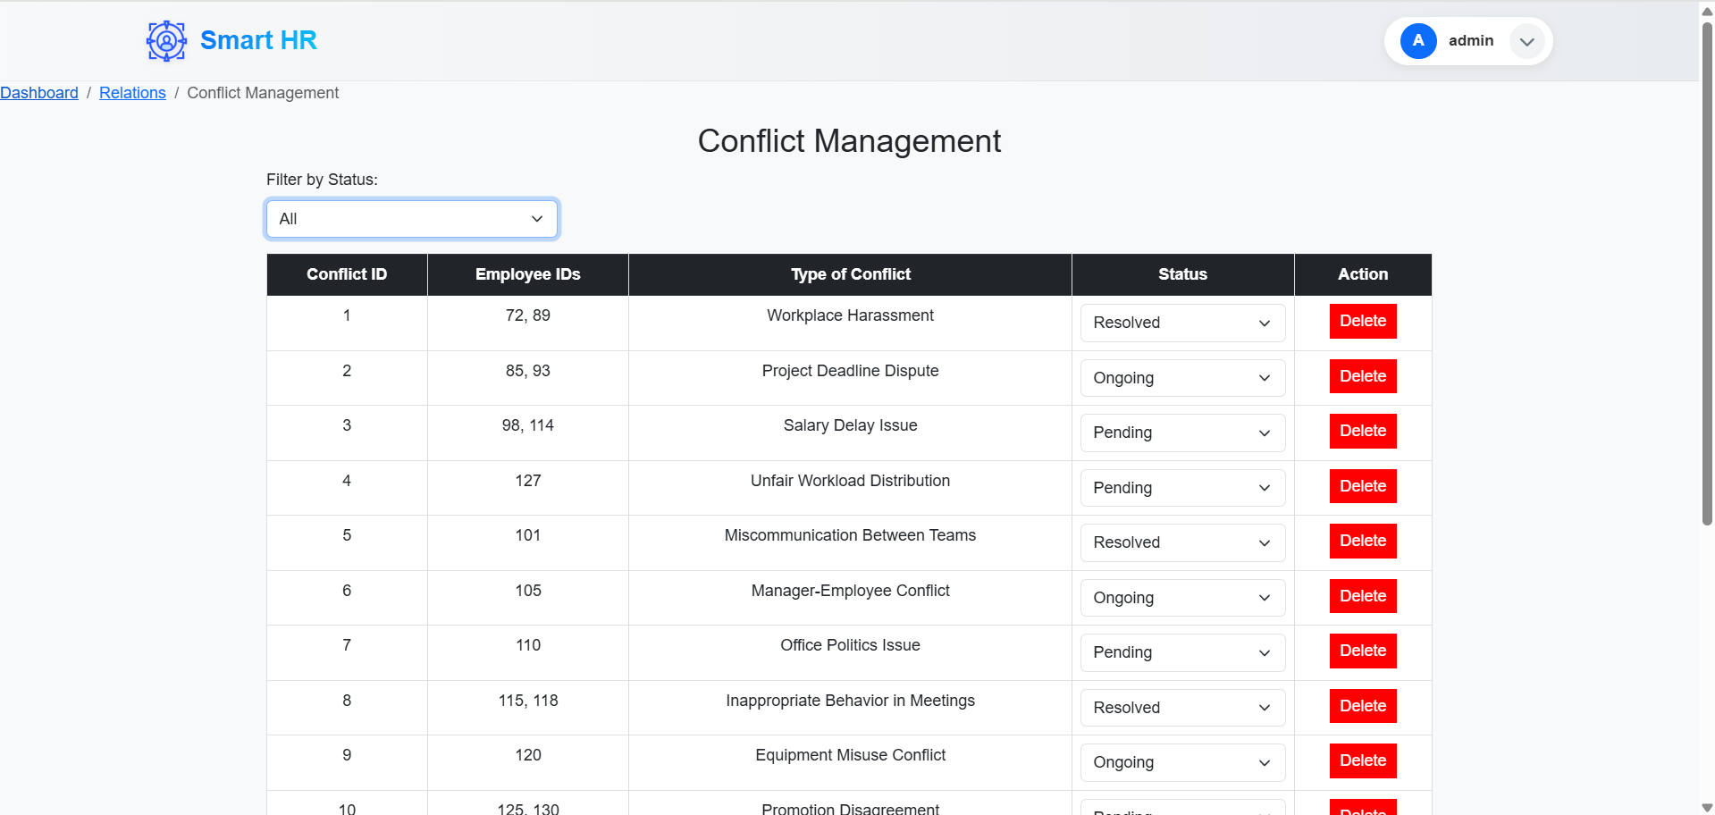
Outcomes
Conflict Management Page

Slide 31
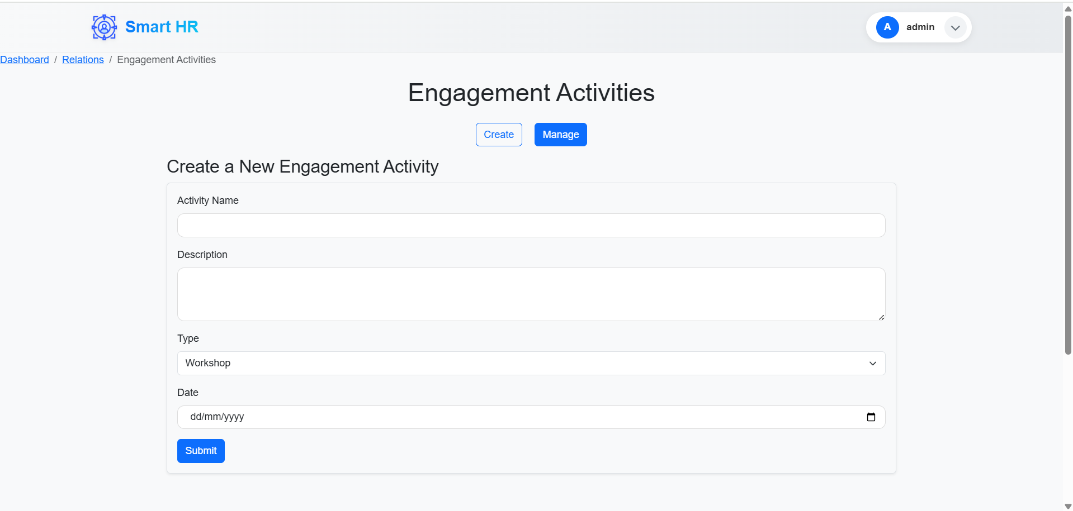
Outcomes
Engagement Activities Page (Create Section)

Slide 32
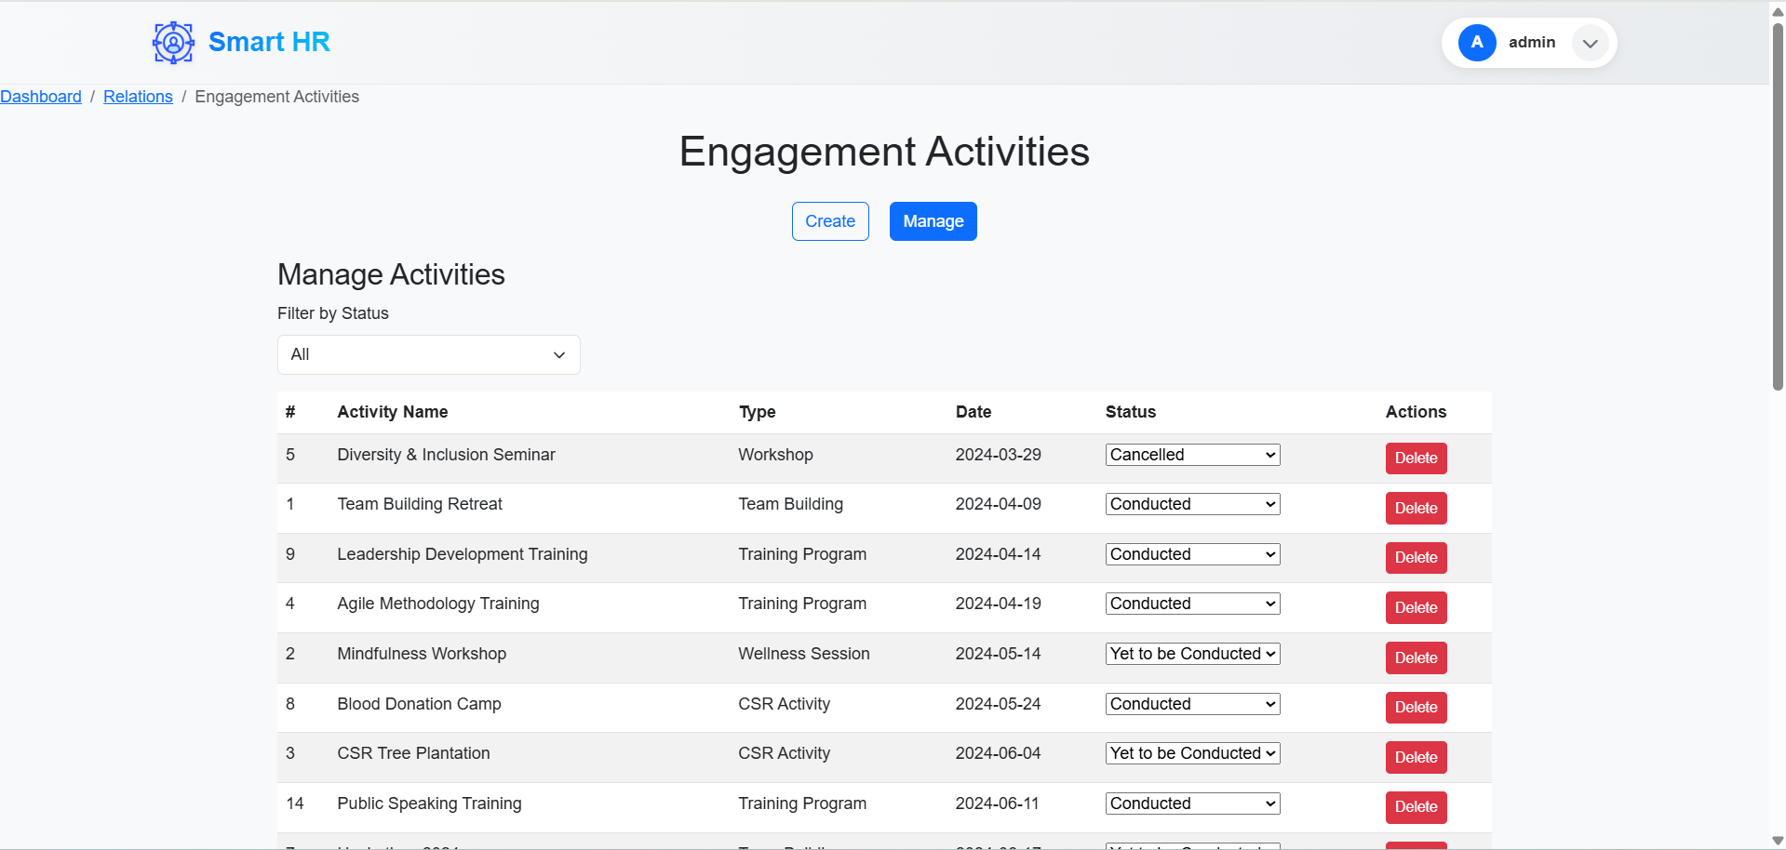
Outcomes
Engagement Activities Page (Manage Section)

Slide 33
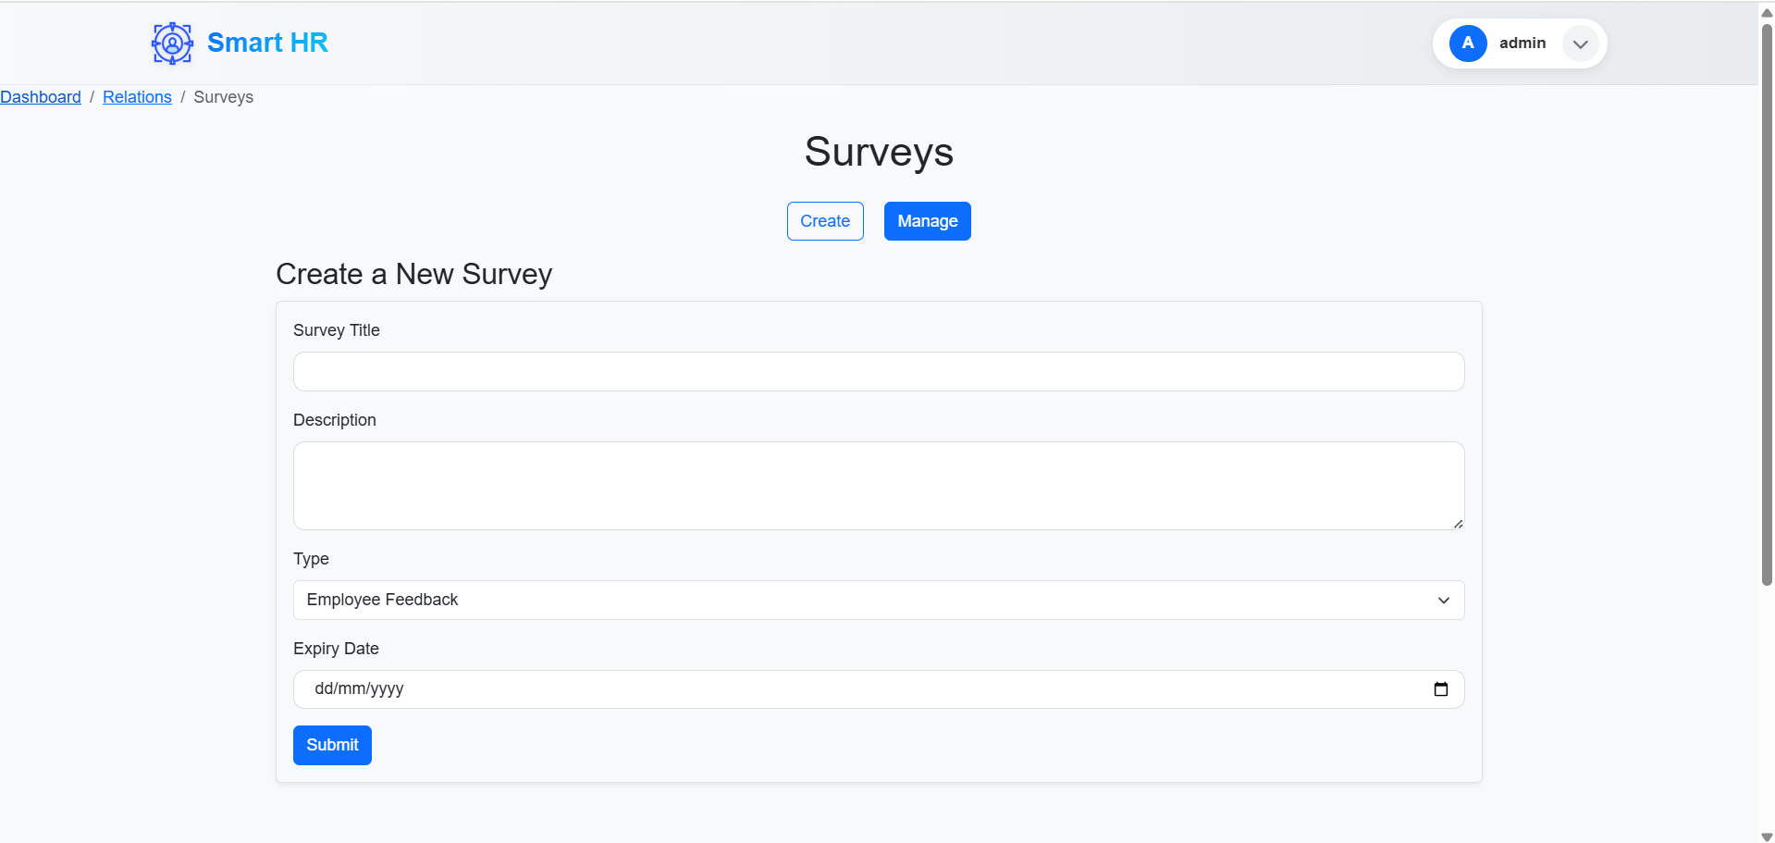
Outcomes
Surveys Page (Create Section)

Slide 34
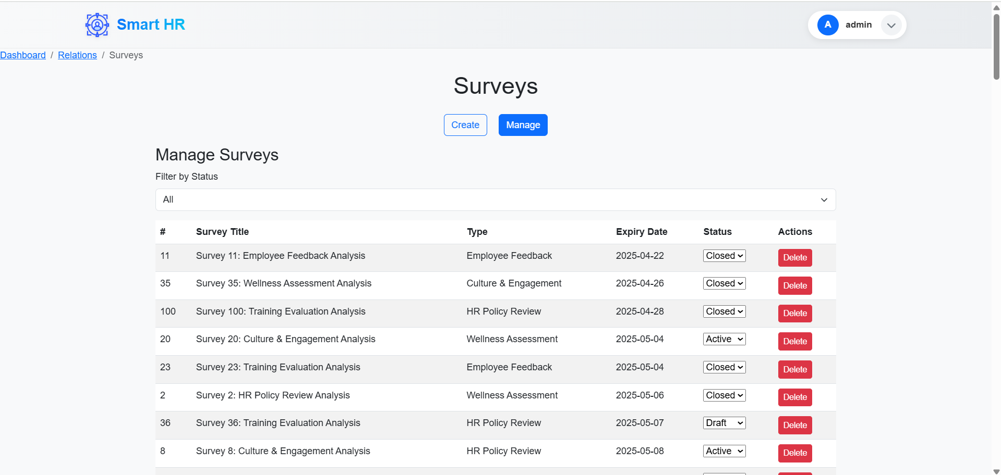
Outcomes
Surveys Page (Manage Sections)

Slide 35
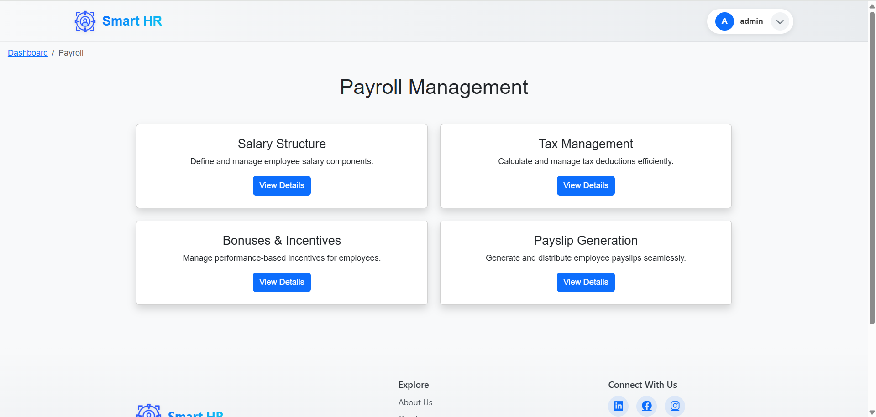
Outcomes
Payroll Page

Slide 36
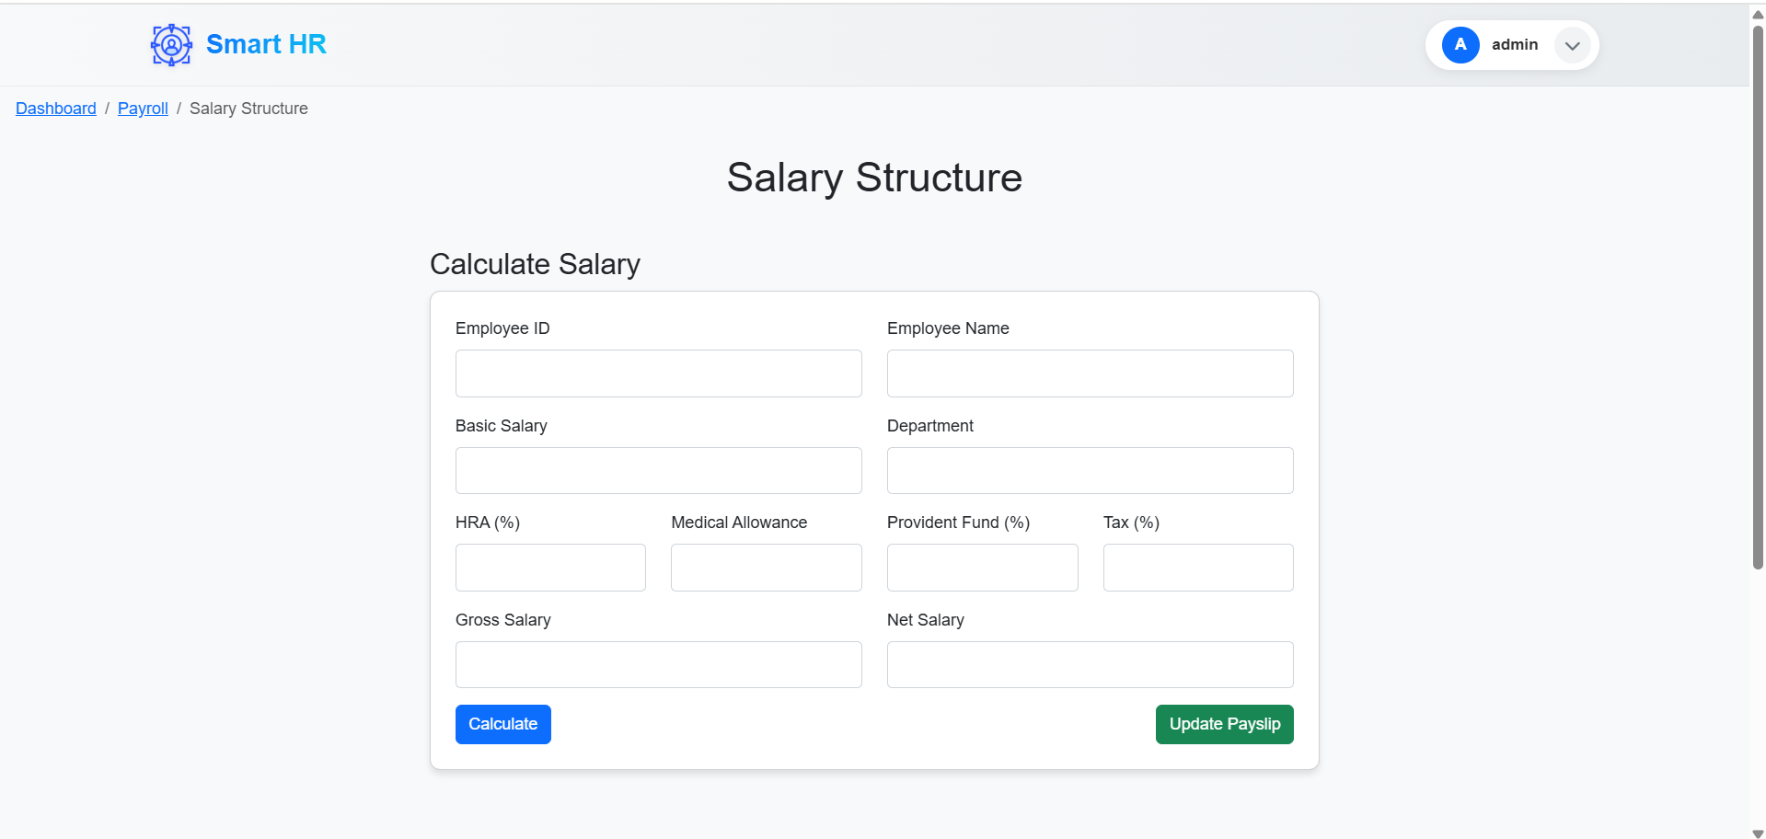
Outcomes
Salary Calculation Page

Slide 37
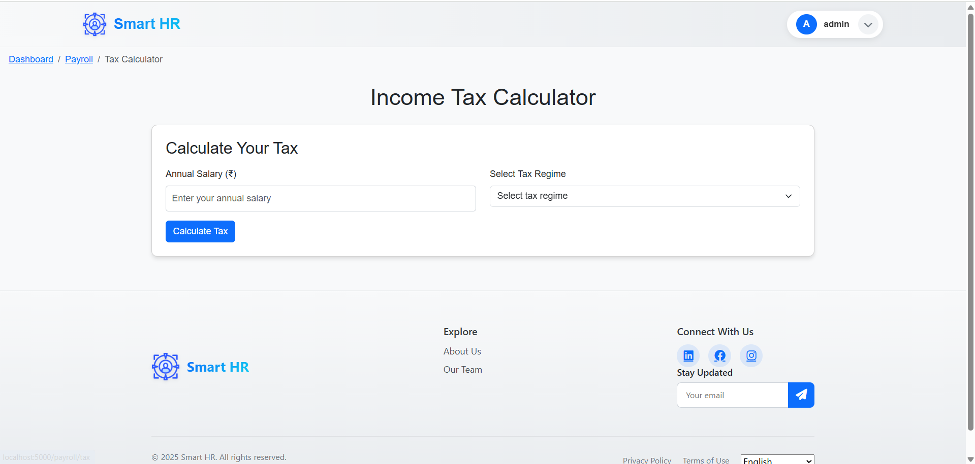
Outcomes
Tax Calculation Page

Slide 38

Outcomes
Employee Bonus Updating Page

Slide 39
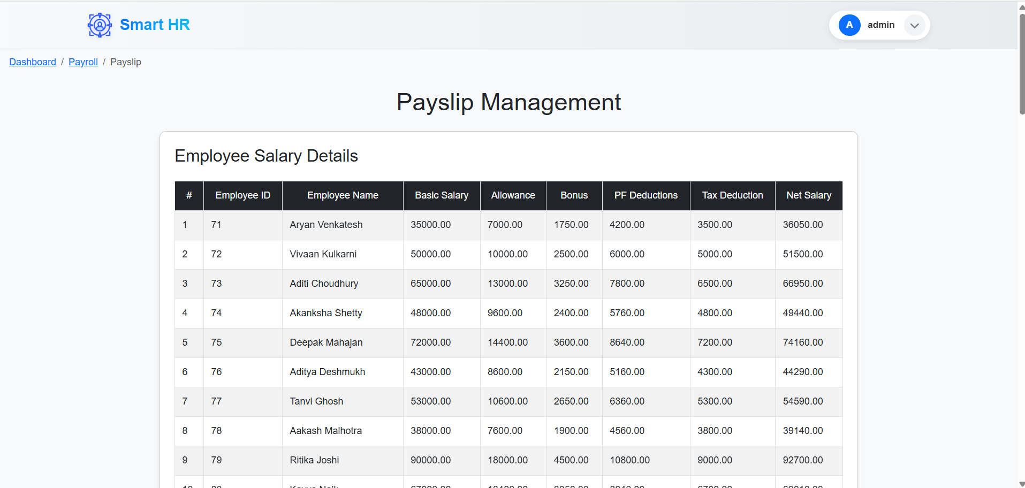
Outcomes
Pay Slip Management Page

Slide 40
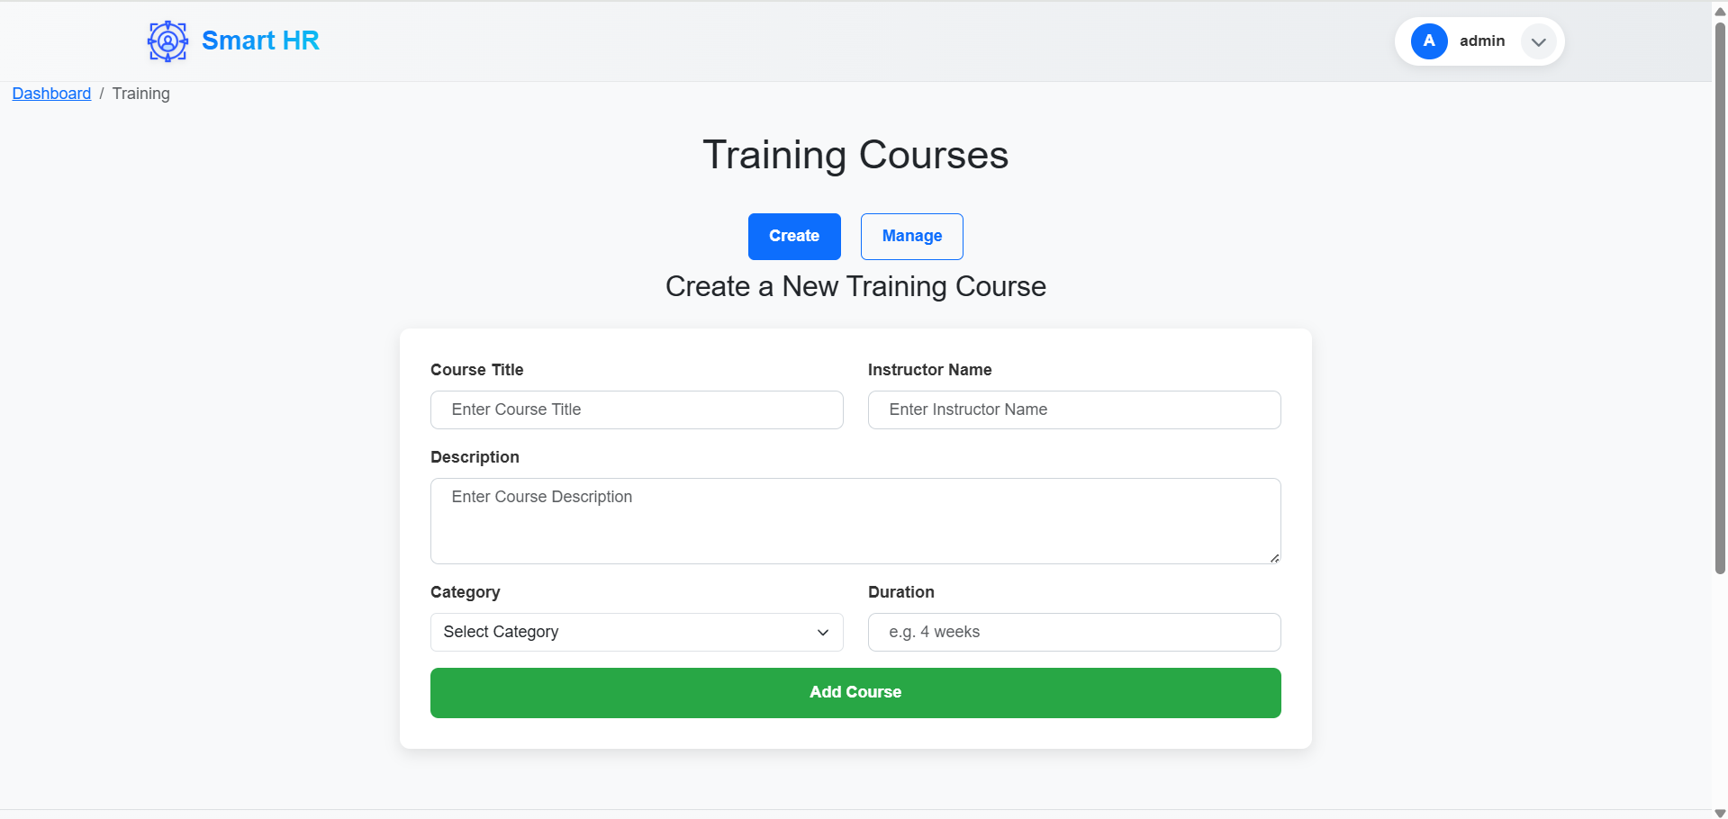
Outcomes
Training Page (Create Section)

Slide 41
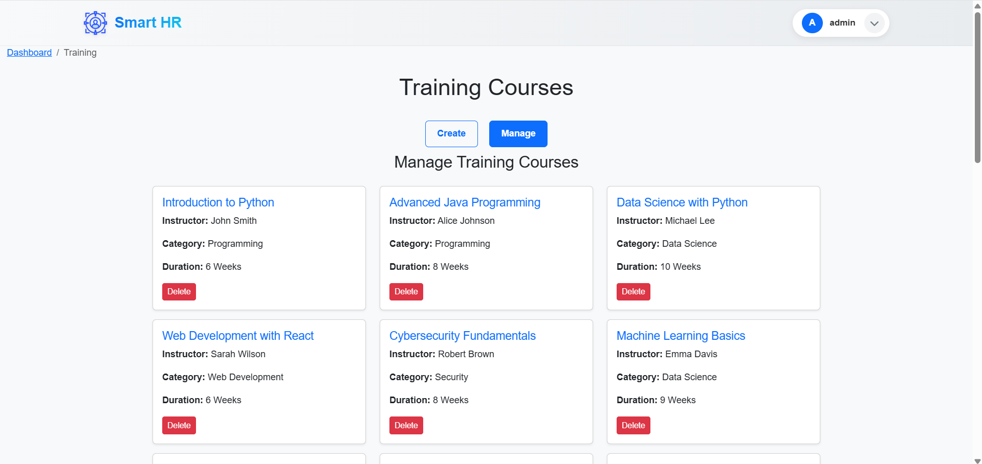
Outcomes
Training Page (Manage Section)

Slide 42
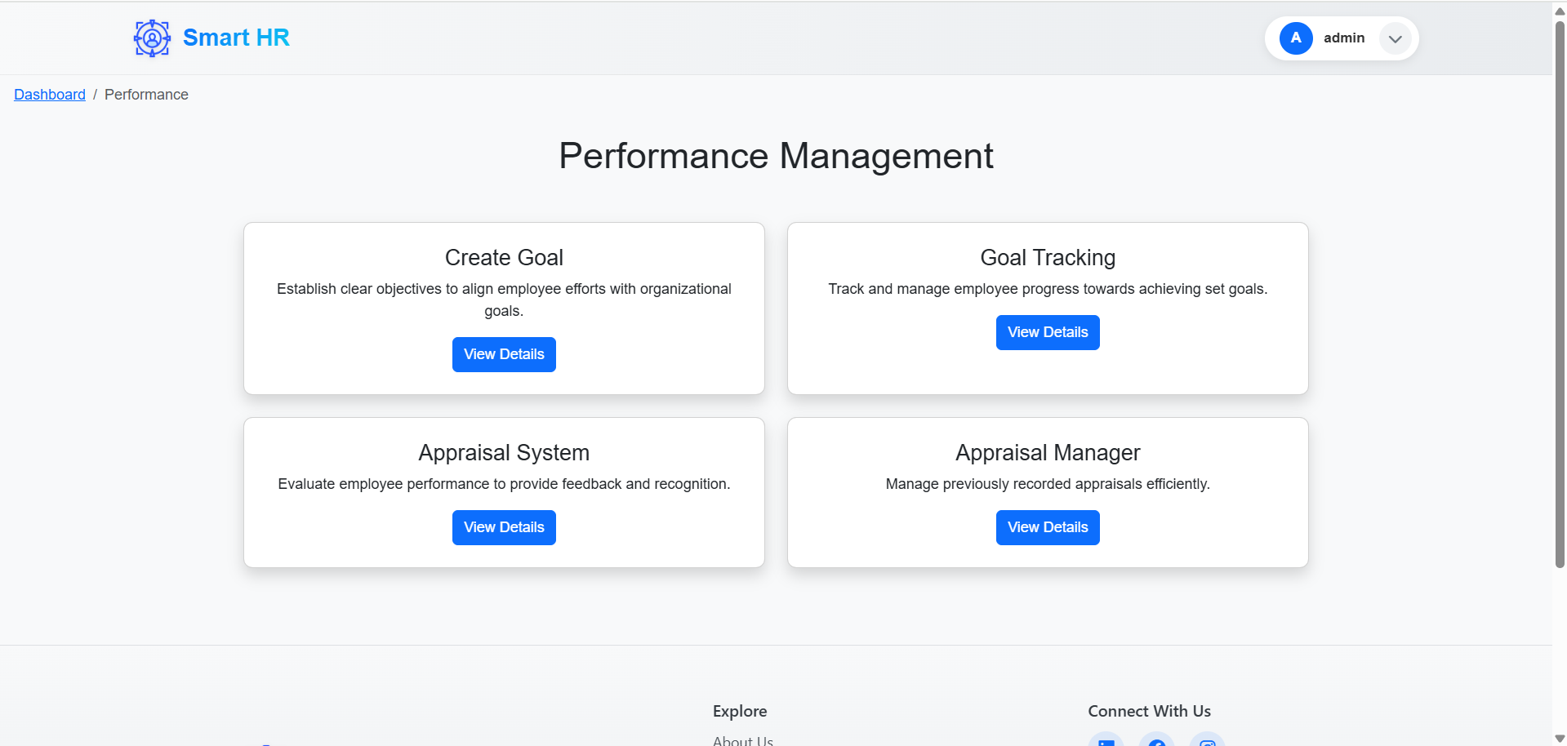
Outcomes
Performance Page

Slide 43
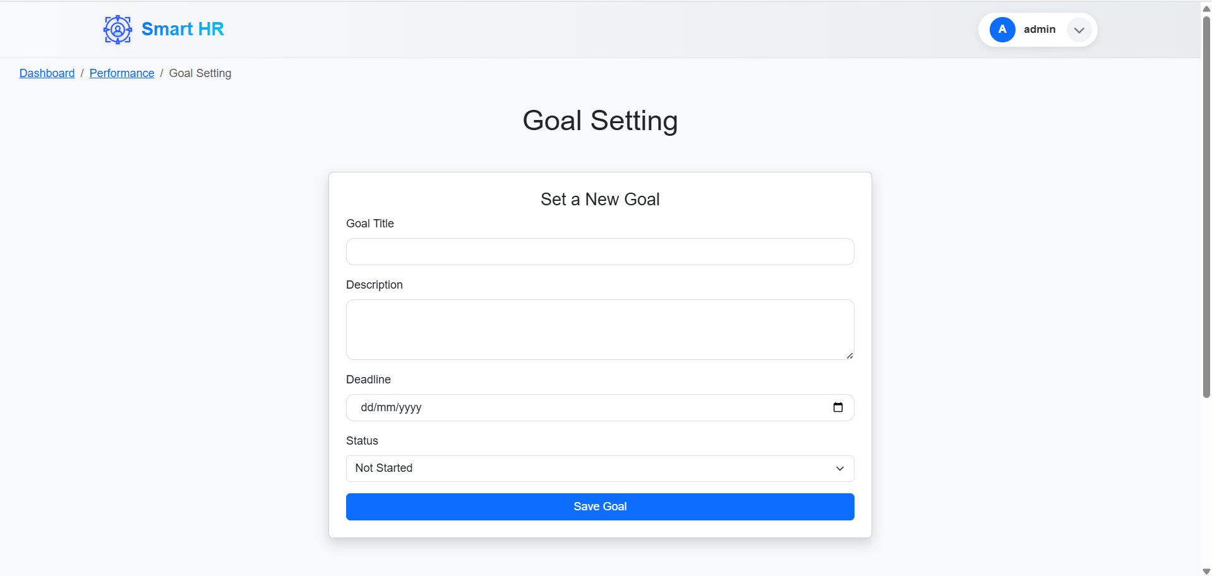
Outcomes
Goal Setting Page

Slide 44
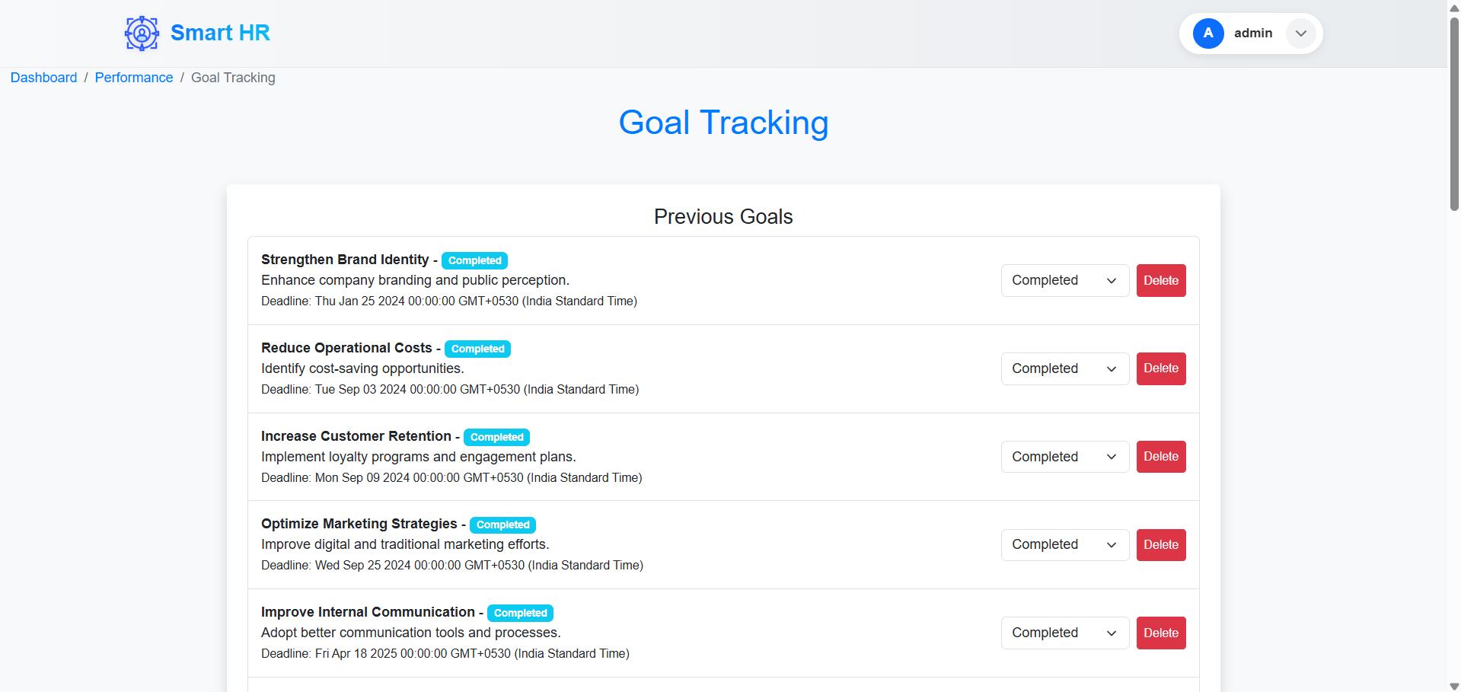
Outcomes
Goal Tracking Page

Slide 45
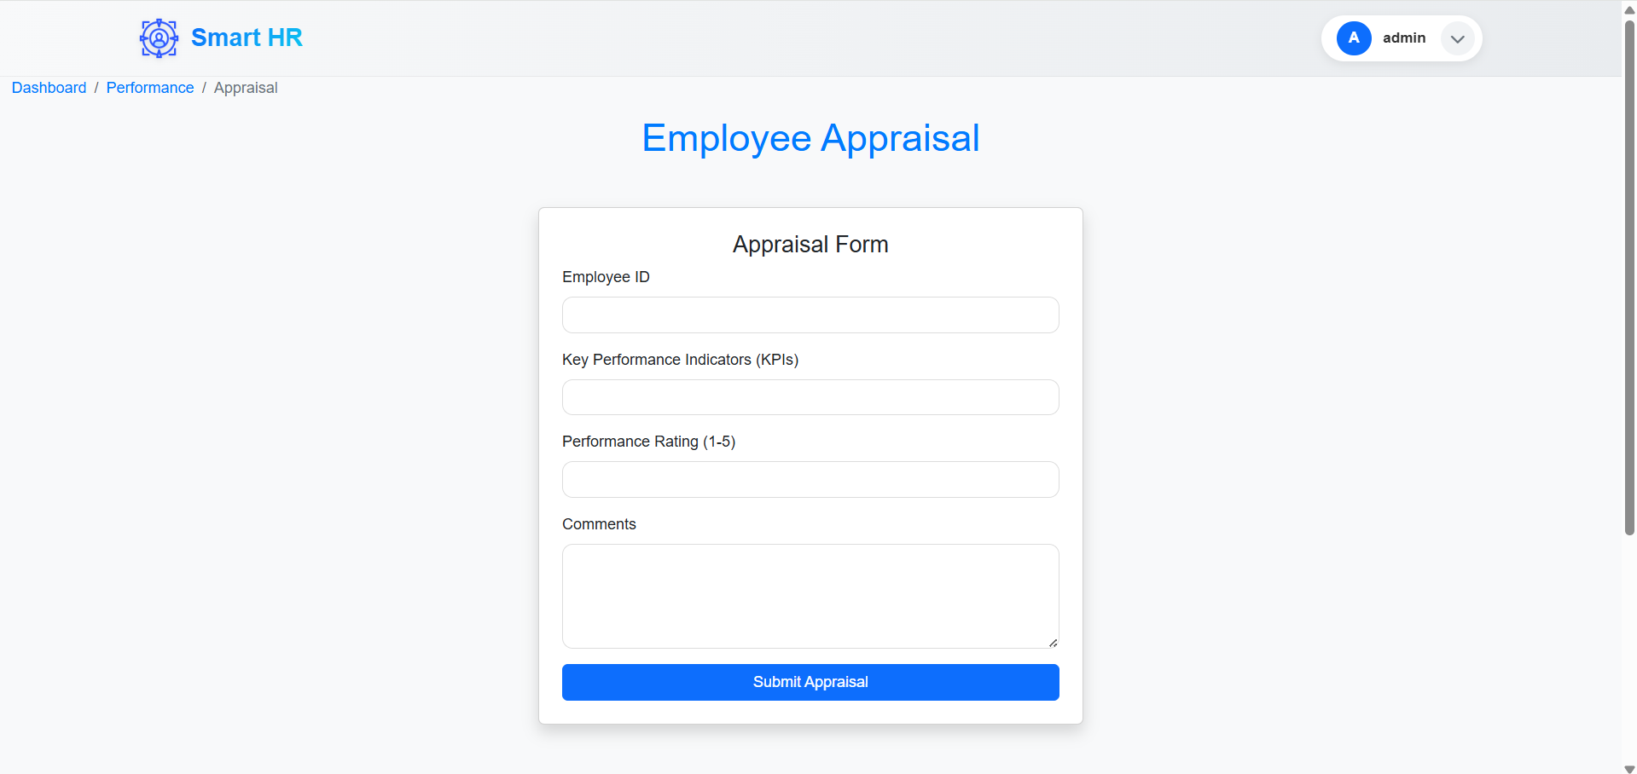
Outcomes
Appraisal Form Page

Slide 46
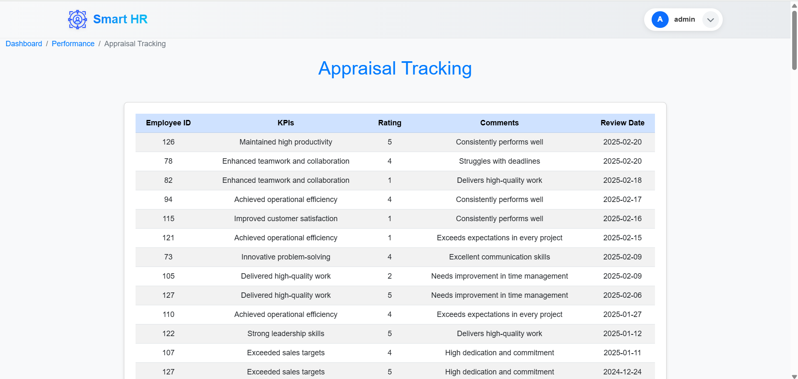
UI Flowchart
Appraisal Tracking Page

Slide 47
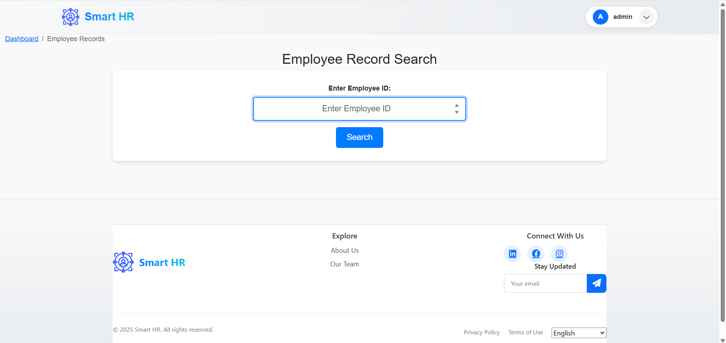
Outcomes
Records Page (Search)

Slide 48
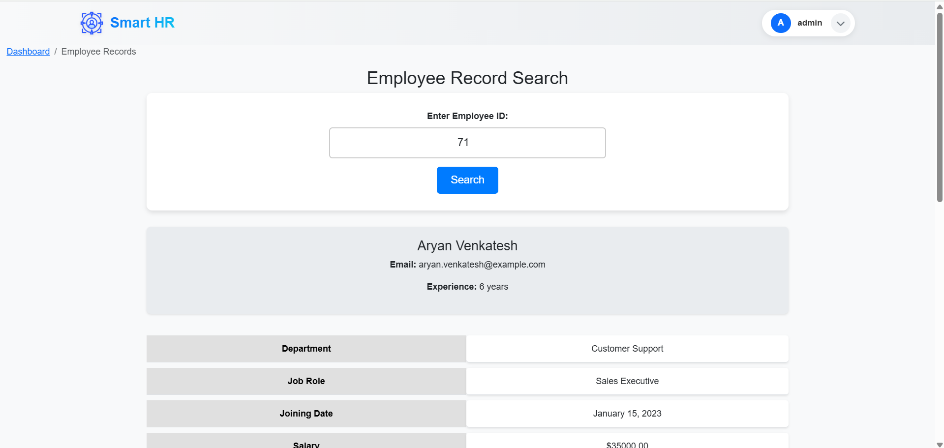
Outcomes
Records Page (Result)

Slide 49
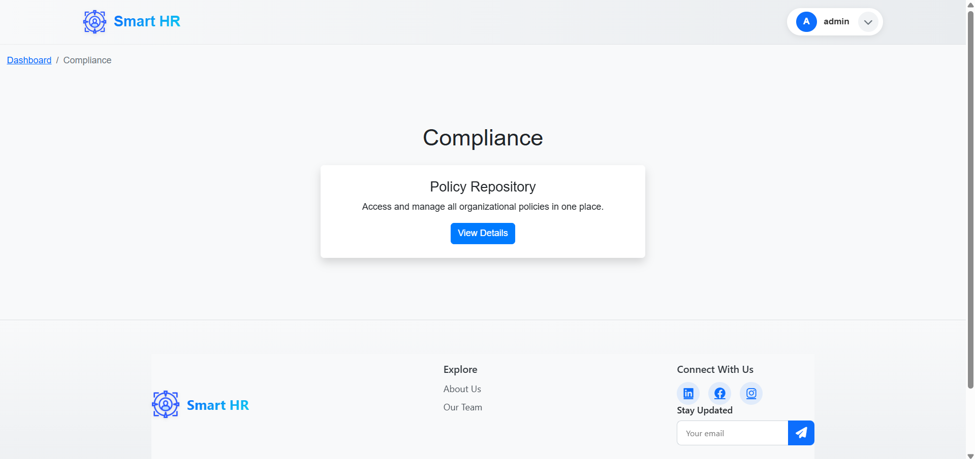
Outcomes
Compliance Page

Slide 50
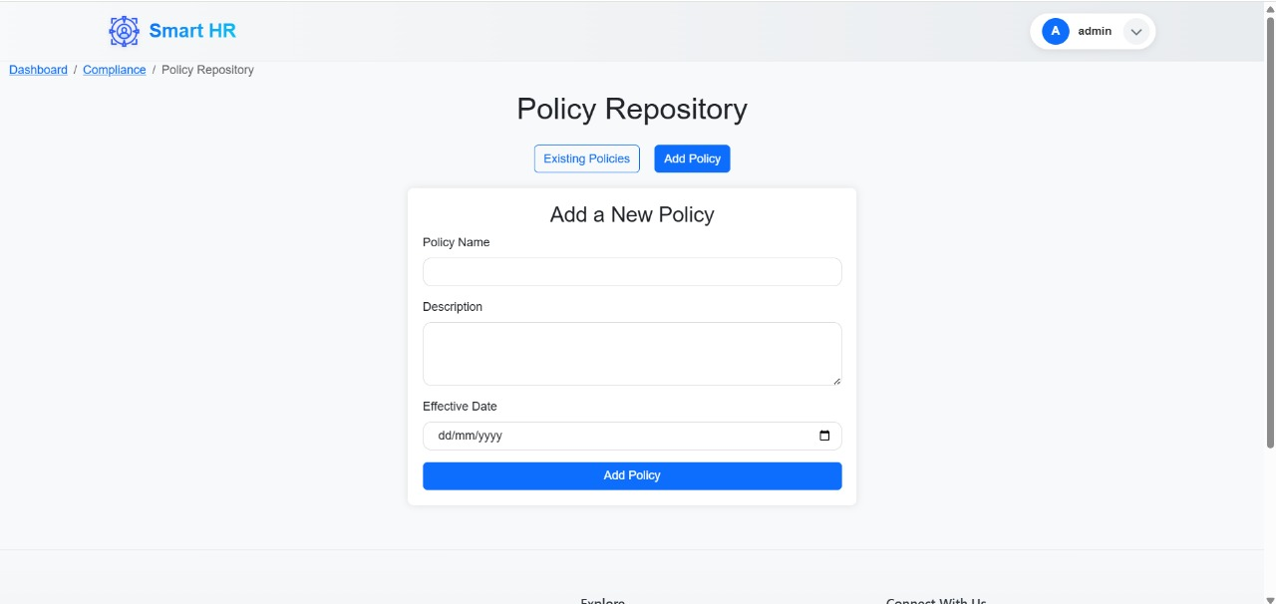
Outcomes
Policy Repository Page (Add Section)

Slide 51
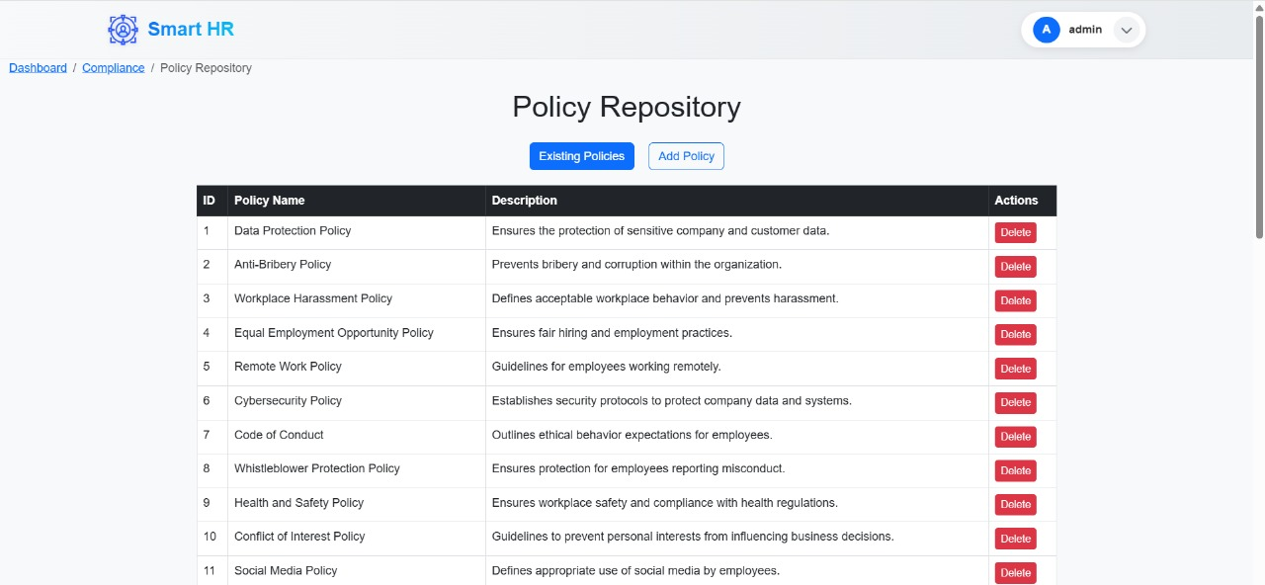
Outcomes
Policy Repository Page (Manage Section)

Slide 52
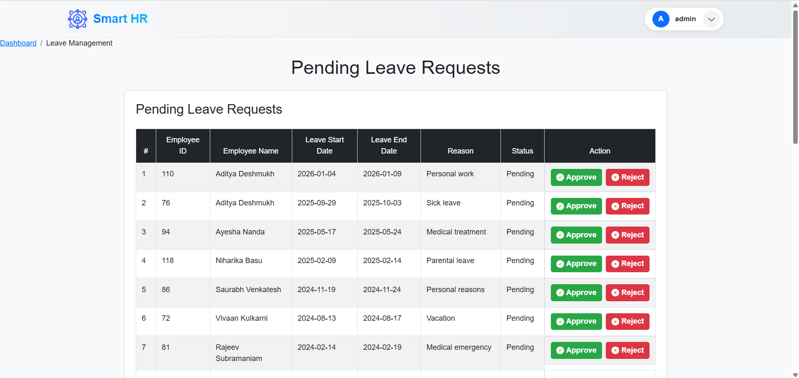
Outcomes
Leave Request Page

Slide 53
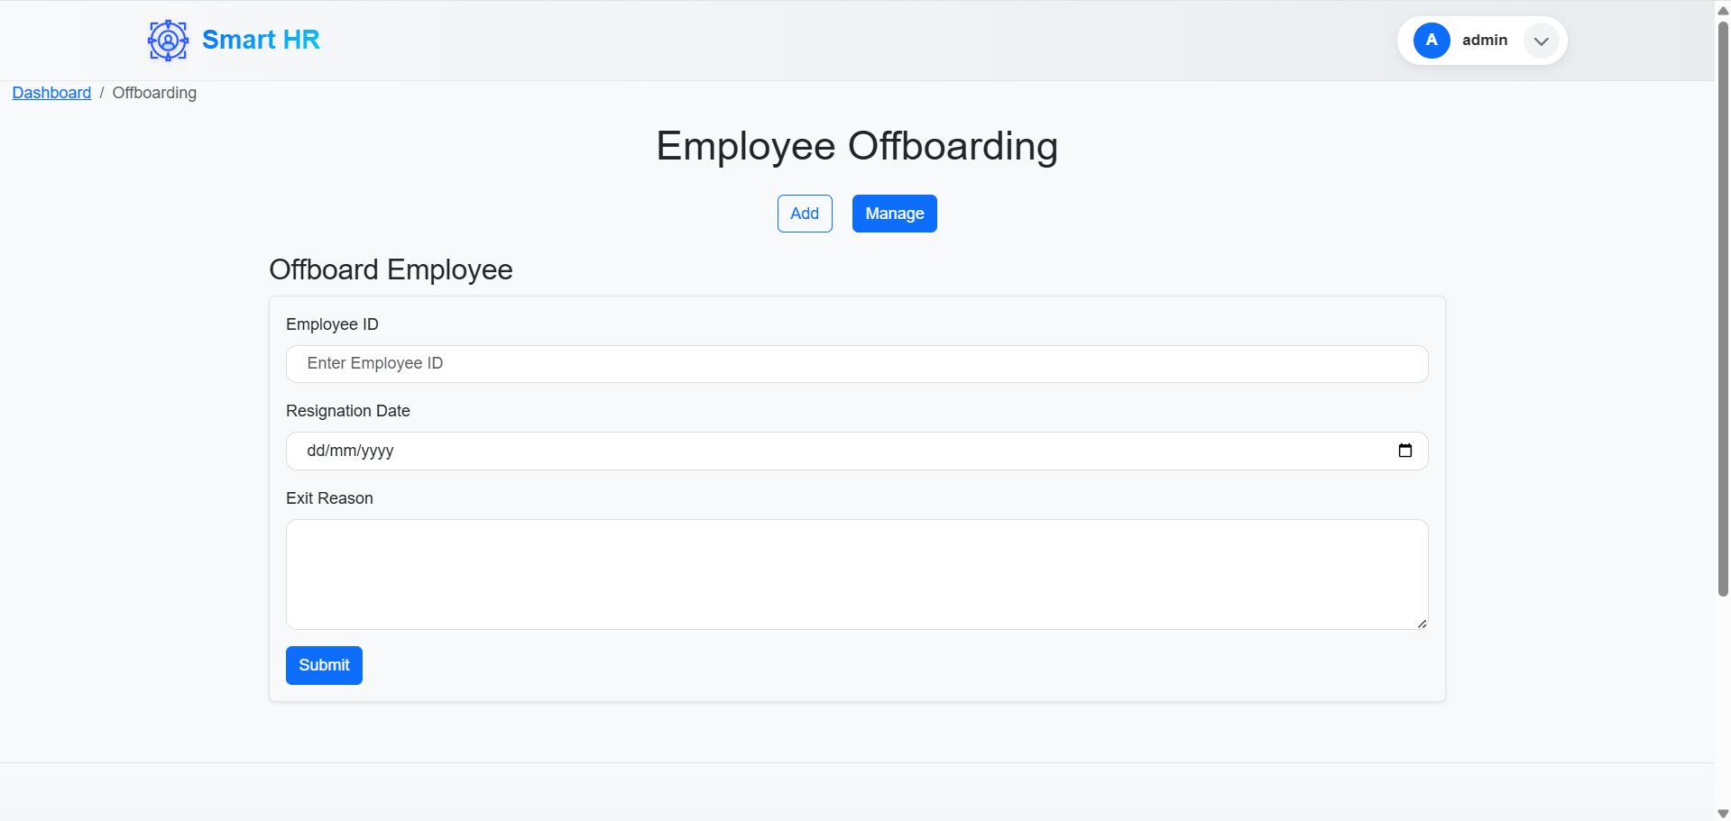
Outcomes
Offboarding Page (Add Section)

Slide 54
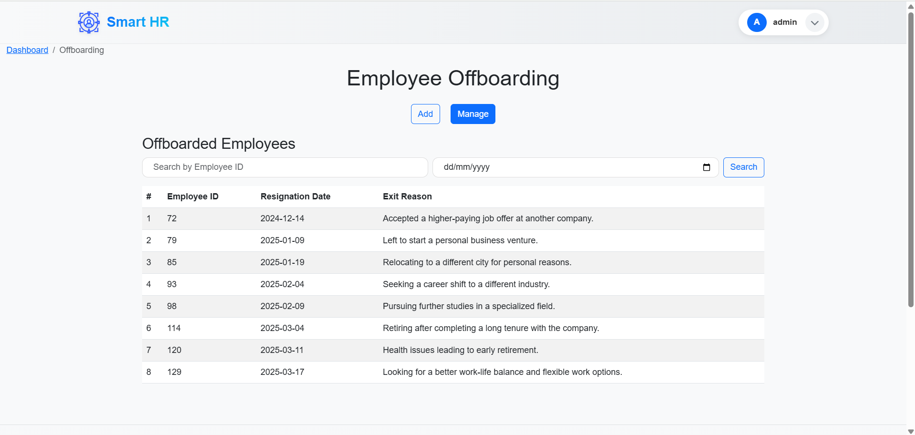
Outcomes
Offboarding Page (Manage Section)

Slide 55
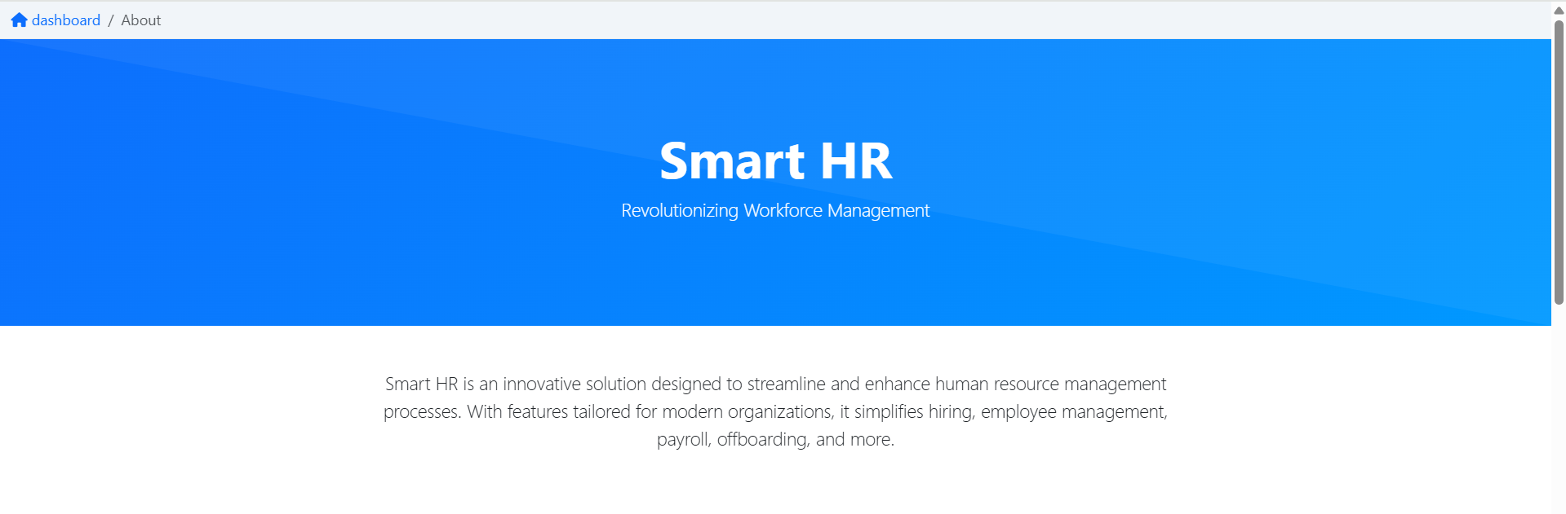
Outcomes
About Us Page (Part 1)

Slide 56
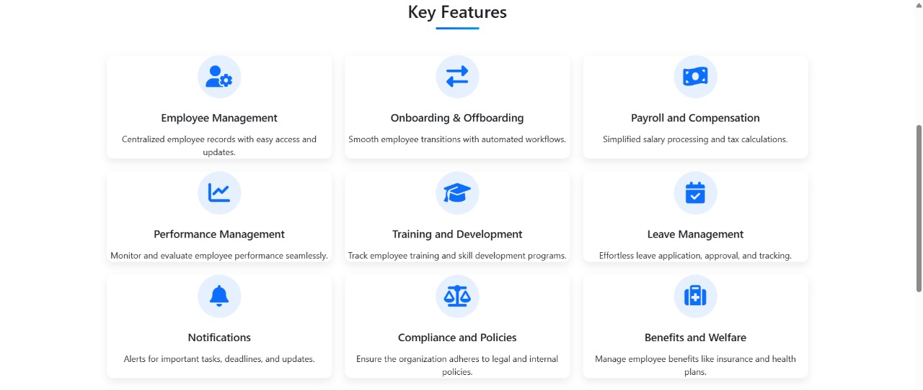
Outcomes
About Us Page (Part 2)

Slide 57

Outcomes
About Us Page (Part 3)

Slide 58

Outcomes
Team Members Page

Slide 59
THANK YOU

